Slide 1
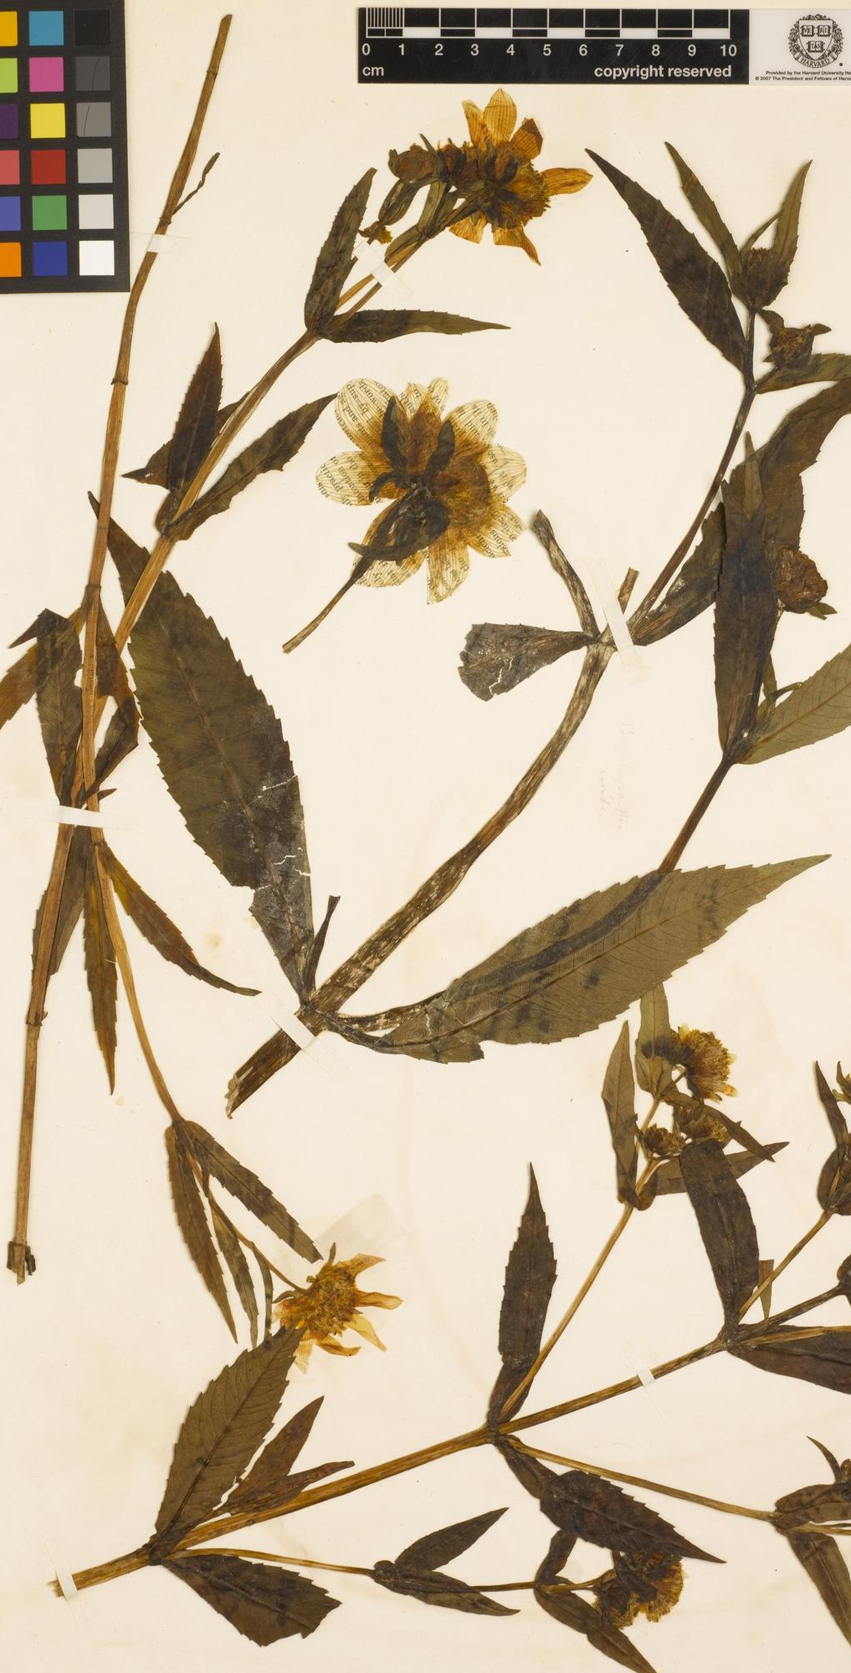
Herbariomics-based biodiversity research: from specimen to phylogeny
All images are subject to © Liming Cai
(CC BY 4.0) unless otherwise noted
Botany 2021 workshop
Liming Cai (UC Riverside daybreak.chua@gmail.com);
Hongrui Zhang (Harvard University zhanghr0429@gmail.com);
Charles C Davis (Harvard University cdavis@oeb.harvard.edu)
Left: Bidens chrysanthemoides The Herbarium of Henry David Thoreau

Slide 2
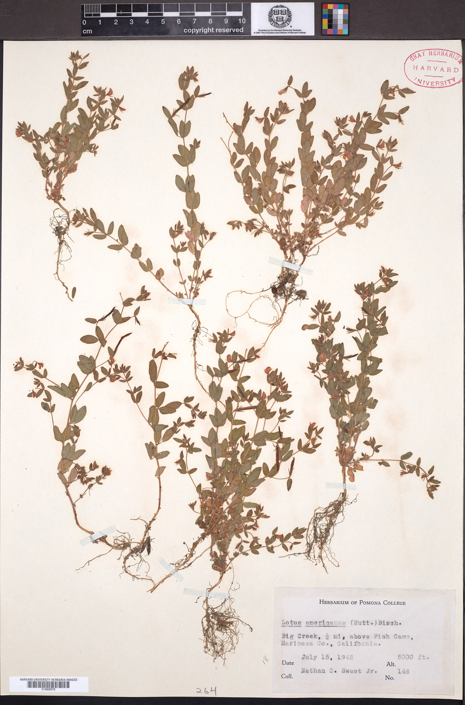
Scale measures
Phenology
Institute stamp
DNA
Morphology
Taxonomy
Distribution
Time
Ecology
Barcode
© Harvard University Herbaria

Slide 3


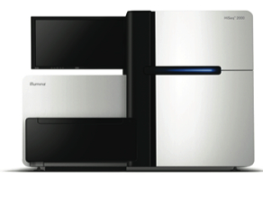


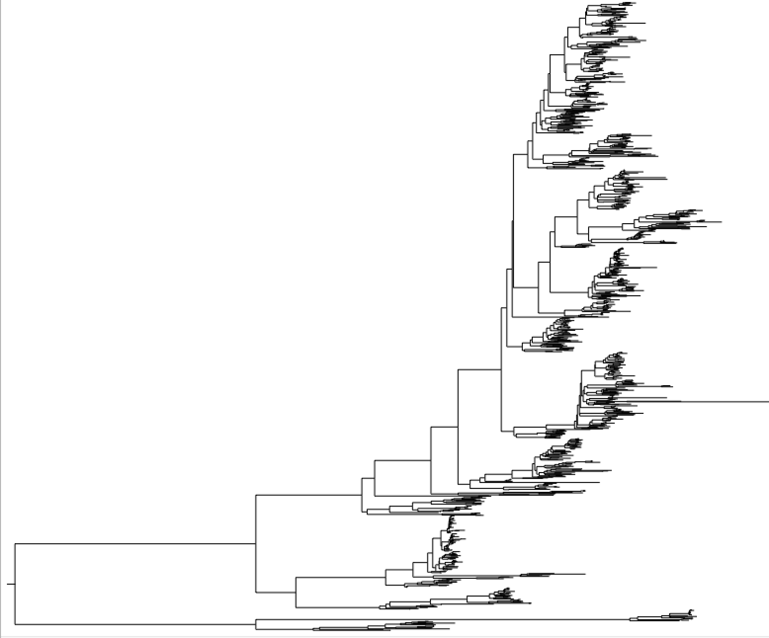




Herbariomics — herbarium specimen sequencing
All workshop materials is available on GitHub:
PhyloHerb (https://github.com/lmcai/PhyloHerb)
DNA extraction
Library preparation, Illumina sequencing
Trait evolution
Biogeography
Phenology
Macroevolutionary hypothesis testing
Phylogeny

Slide 4
Why using herbarium specimens?
All workshop materials is available on GitHub:
PhyloHerb (https://github.com/lmcai/PhyloHerb)
Pros:
Easy access to materials
Nearly perfect taxon sampling
Reliable taxonomy, locality, morphology, etc.
Fragmented DNA suitable for Illumina sequencing
Cons:
DNA quality
Restrictions for special collections
Preserve conditions

Slide 5
All workshop materials is available on GitHub:
PhyloHerb (https://github.com/lmcai/PhyloHerb)

Slide 6
Experiment design — Which reduced-representation sequencing to use?
All workshop materials is available on GitHub:
PhyloHerb (https://github.com/lmcai/PhyloHerb)
Genome skimming
Unbiased sampling of the genome
Target enrichment/Sequence capture
Enriching target regions
ddRAD seq, GBS, etc.

Slide 7
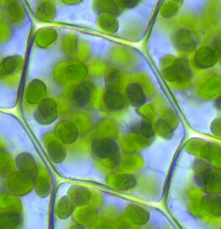
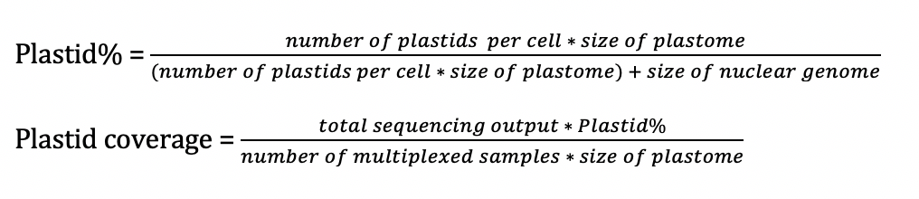
Experiment design — Which reduced-representation sequencing to use?
All workshop materials is available on GitHub:
PhyloHerb (https://github.com/lmcai/PhyloHerb)
Genome skimming
Unbiased sampling of the genome
nuclear
mito
plastid
Illumina sequencing
Plant cell

Slide 8
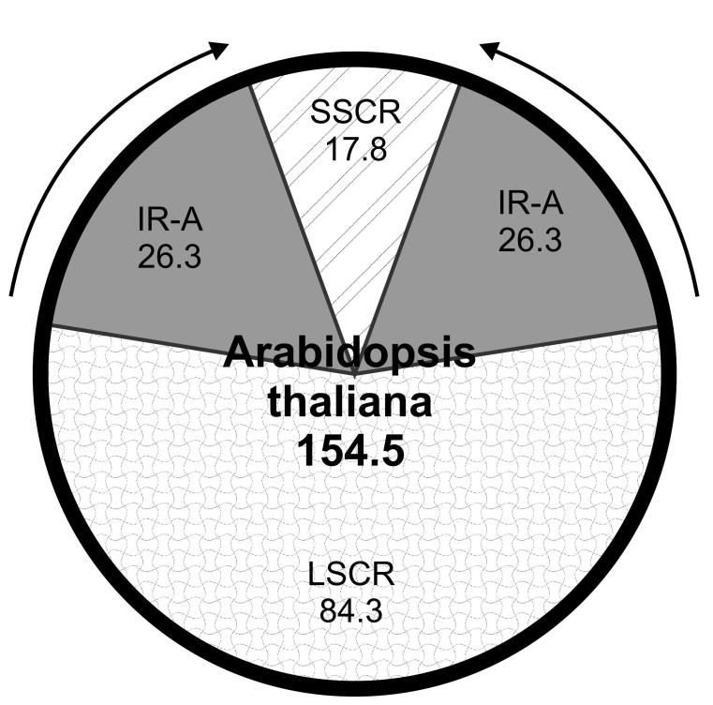
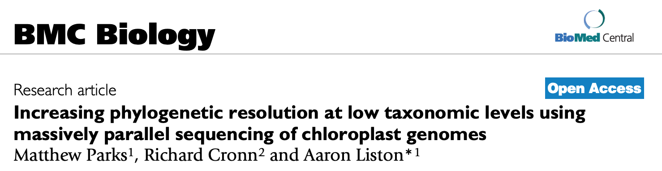
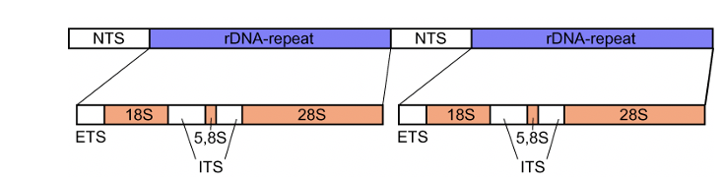

Experiment design — Which reduced-representation sequencing to use?
All workshop materials is available on GitHub:
PhyloHerb (https://github.com/lmcai/PhyloHerb)
Genome skimming
Unbiased sampling of the genome
Overrepresented regions
plastid genome (150-160 kb)
ribosomal regions (~10 kb)
mitochondrial genome (varies)
Phylogenetic application of plastome
Single copy
Conserved sequence (easy to align)
Phylogenetically infomative
Olejniczak et al., 2016

Slide 9
Experiment design — Which reduced-representation sequencing to use?
All workshop materials is available on GitHub:
PhyloHerb (https://github.com/lmcai/PhyloHerb)
Target enrichment/Sequence capture/Hyb-Seq
Enriching target regions
Hundreds of unlinked genetic loci
nuclear
mito
Probe1
Probe2
Probe3
plastid
Step 1: Illumina library prep
Step 2: Capture target region
Plant cell

Slide 10
Experiment design — Which regions to target?
All workshop materials is available on GitHub:
PhyloHerb (https://github.com/lmcai/PhyloHerb)
Estimations below are very rough!!!
 | Genome skimming | Target enrichment
Target region | Plastome, ribosomal regions, mitochondrial | Highly conserved nuclear (mostly) regions and the flanking region
Output per species | 160 kb (plastome) + 6-9 kb (rDNA) + 10 kb (mito) = 180 kb | ~400 loci x 400 bp = 160 kb (depends on the probes)
Minimum data | 50 - 100 Mb / sample | ~ 1 Gb / sample
Price | $20 for library prep + $6 for sequencing | $35 for library prep + $30 for sequencing
Data processing | Easy, but not suitable for testing hybridization or coalescence | Tricky (missing data, paralog, flanking region), but can test complex evolution history
Phylogenetic informativeness | Informative at all depth, but rapid radiations are challenging | Informative at all depth, but potential bias in missing data, high gene tree error due to short alignments

Slide 11
Experiment design — Working on a budget? Less manual effort?
All workshop materials is available on GitHub:
PhyloHerb (https://github.com/lmcai/PhyloHerb)
DNA extraction
Massive, inexpensive extraction system
NGS library preparation
¼ reaction
Library reconstruction service
Sequencing
Multiplex samples

Slide 12
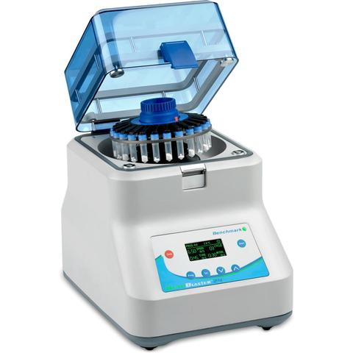
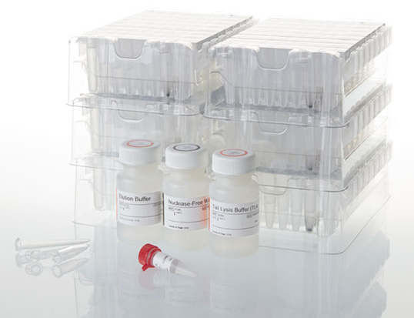
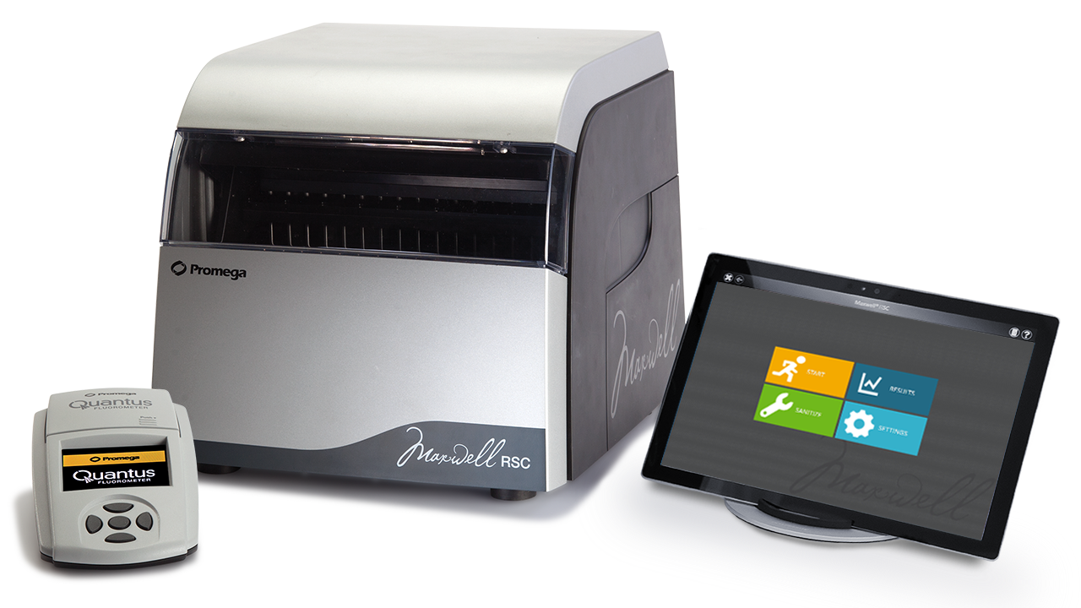
Experiment design — Working on a budget? Less manual effort?
All workshop materials is available on GitHub:
PhyloHerb (https://github.com/lmcai/PhyloHerb)
DNA extraction
CTAB or commercial kits $6-9, low-throughput
Massive, inexpensive extraction system
96-well plate DNA extraction (Folk et al, APPS 2021): 400–600 samples per person-week
Maxwell® RSC Instrument + Maxwell® RSC Plant DNA Kit: 16 samples per 40 min
Incubate overnight
16 samples / 40 min
Tissue homogenizer
Maxwell plant kit ($5 per sample)
Maxwell instrument

Slide 13
Experiment design — Working on a budget? Less manual effort?
All workshop materials is available on GitHub:
PhyloHerb (https://github.com/lmcai/PhyloHerb)
NGS library preparation
DNA QC + NGS library prep + library clean-up (e.g., KAPA pure beads)
Commercial library reconstruction service
KAPA HyperPlus Kit ¼ reaction: $17 per sample

Slide 14
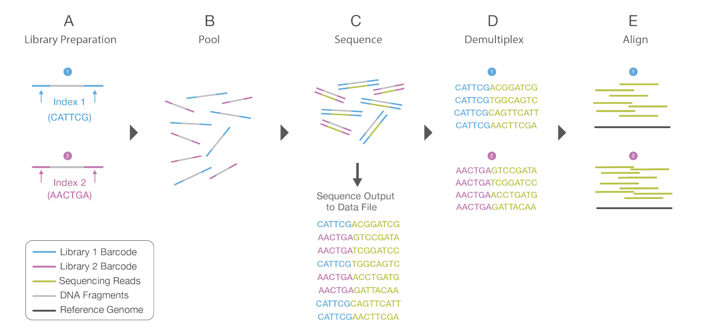
Experiment design — Working on a budget? Less manual effort?
All workshop materials is available on GitHub:
PhyloHerb (https://github.com/lmcai/PhyloHerb)
Sequencing
Multiplex samples to reduce costs
Illumina sequencing plantforms
HiSeq: $2,200 per lane, 55-65 Gb (HiSeq 4000 PE150)
NovaSeq: $3,200 per lane, 175-200 Gb (NovaSeq S1 PE100)
60 Gb output, 2% plastid reads, 384 samples, 160 kb plastome
= 20X coverage (156 Mb data)

Slide 15
Experiment design — Working on a budget? Less manual effort?
All workshop materials is available on GitHub:
PhyloHerb (https://github.com/lmcai/PhyloHerb)
Sequencing
Multiplex samples to reduce costs
Illumina sequencing plantforms
HiSeq: $2,200 per lane, 55-65 Gb (HiSeq 4000 PE150)
NovaSeq: $3,200 per lane, 175-200 Gb (NovaSeq S1 PE100)
60 Gb output, 2% plastid reads, 384 samples, 160 kb plastome
= 20X coverage (156 Mb data)

Slide 16
Experiment design — Working on a budget? Less manual effort?
All workshop materials is available on GitHub:
PhyloHerb (https://github.com/lmcai/PhyloHerb)
Sequencing
Maximum number of samples
384 in most cases, e.g., NextFlex-HT barcode (Bioo Scientific)
More aggressive multiplexing?
Dual barcodes or custom barcodes (potentially technical bottleneck)
Risk: library overrepresentation
talk to your sequencing facility
Input data
20 M 50 M 100 M 200 M 1G
Failed
assembly
50% genes
Most genes
+ 50% intergenic
Nearly
complete
Circular
Plastid genome

Slide 17
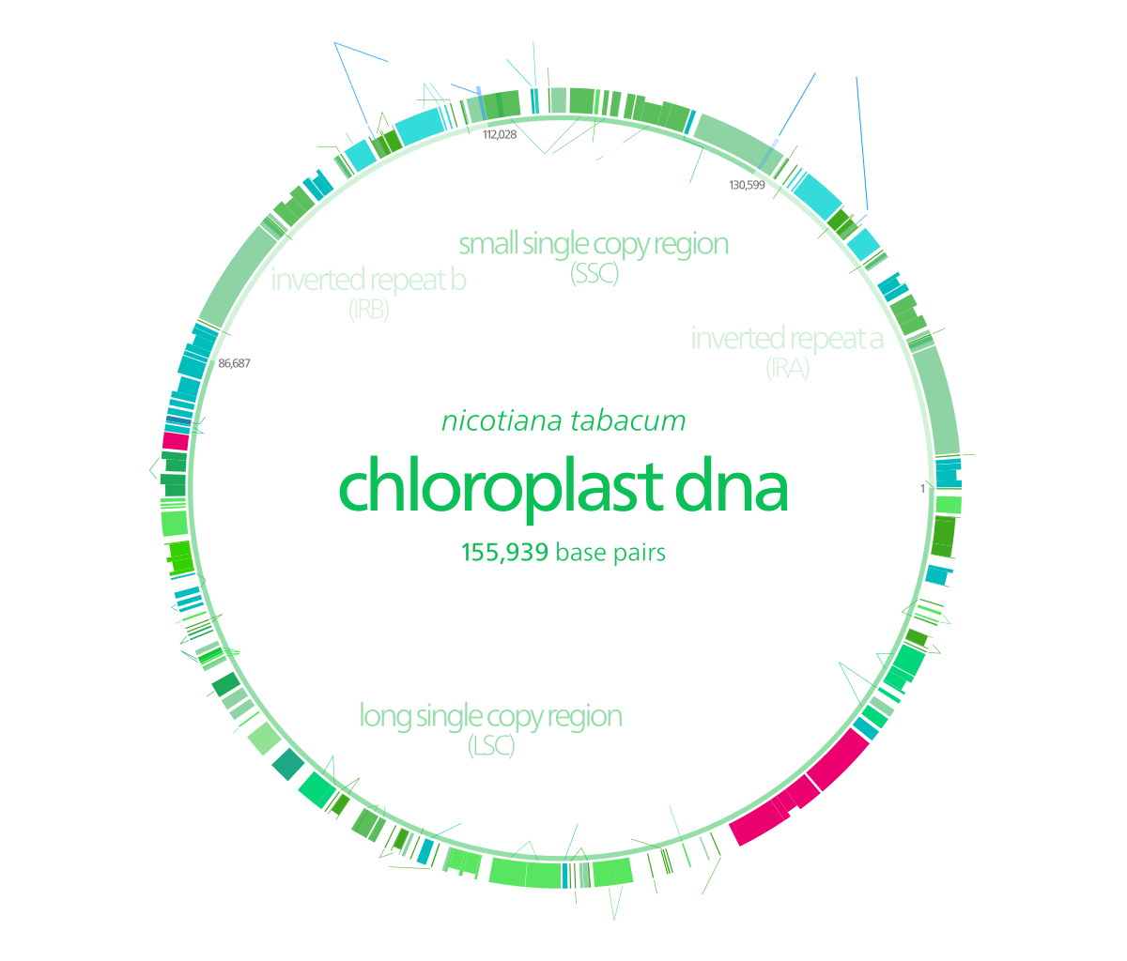
Bioinformatic Workflow
All workshop materials is available on GitHub:
PhyloHerb (https://github.com/lmcai/PhyloHerb)
Illumina reads
GetOrganelle:
Plastid genome, mito-genome, rDNA
Circularized genomes:
Annotation, structural variation
reference
PhyloHerb:
Ortholog extraction
PhyloHerb:
Alignment
Phylogeny
Phylogeny

Slide 18
Schedule
All workshop materials is available on GitHub:
PhyloHerb (https://github.com/lmcai/PhyloHerb)
1:00 – 1:30 PM I. Introduction to herbariomics
1:30 – 2:30 PM II. Plastome assembly using GetOrganelle
2:30 – 2:40 PM Break
2:40 – 3:00 PM III. Annotation using GeSeq
3:00 – 4:00 PM IV. Alignment assembly and curation
4:00 – 4:10 PM Break
4:10 – 4:30 PM V. Phylogeny reconstruction
4:30 – 5:00 PM Q&A

